Slide 1

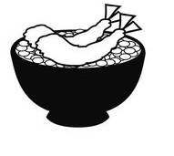




Let me see
Who you are

Slide 2



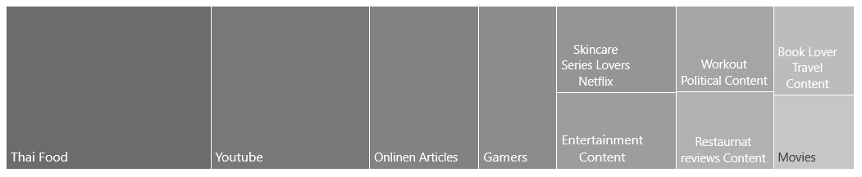
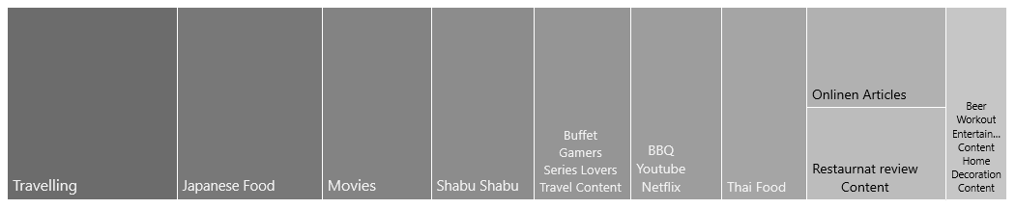
What I’ve got…
We asked 62 persons in class
Top 10 interest - I extremely loved it!
45%
39%
29%
27%
26%
24%
23%
19%
16%
Gender :
18%
33
28
1
Top 10 consume – I did it almost everyday
84%
65%
45%
32%
26%
21%
18%
Age :
20-29 > 30
30-39 > 27
40-49 > 5
23%
19%
15%
Do you see something? Sometimes , what we love is not what we can do in everyday…

Slide 3
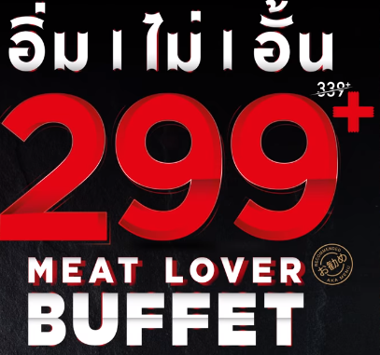
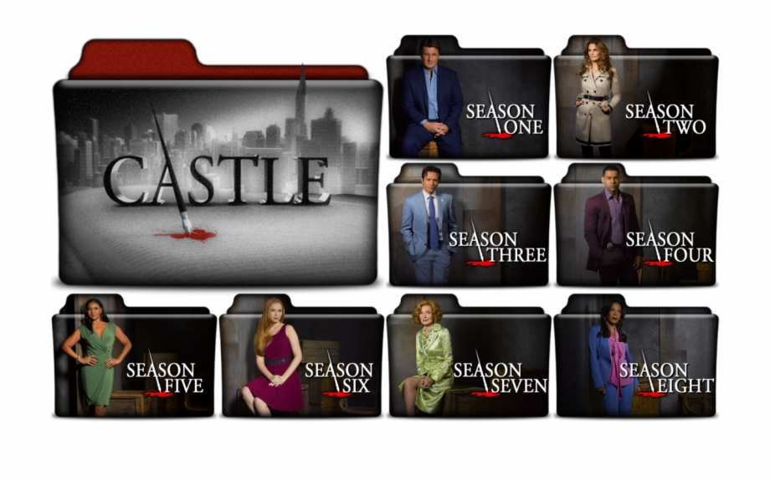
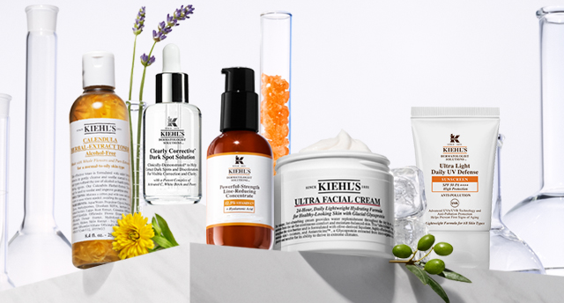

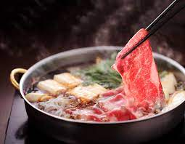
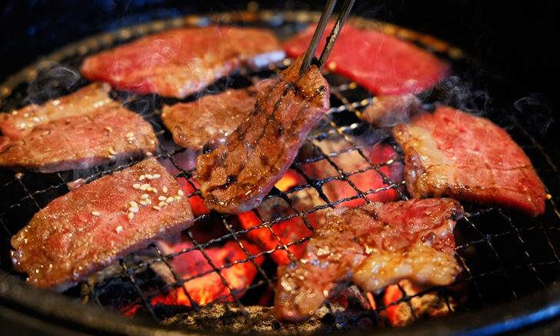

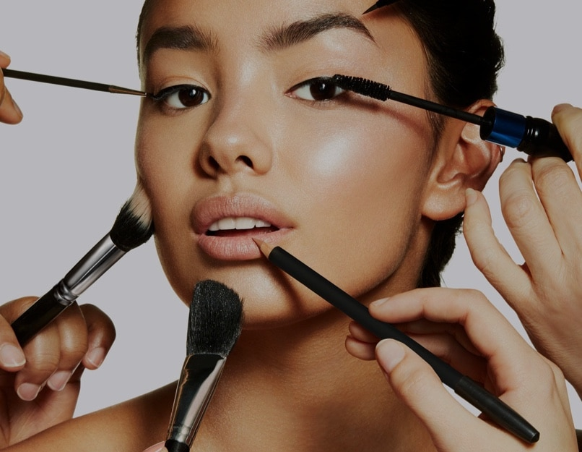

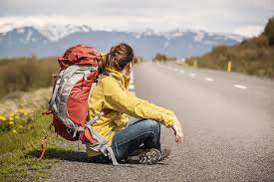



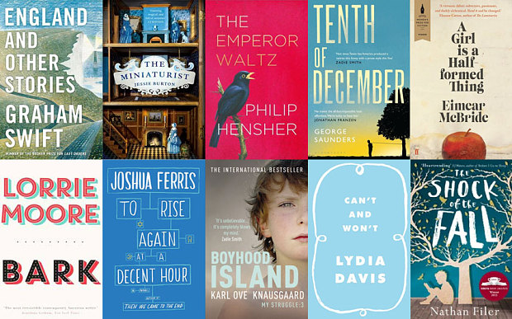
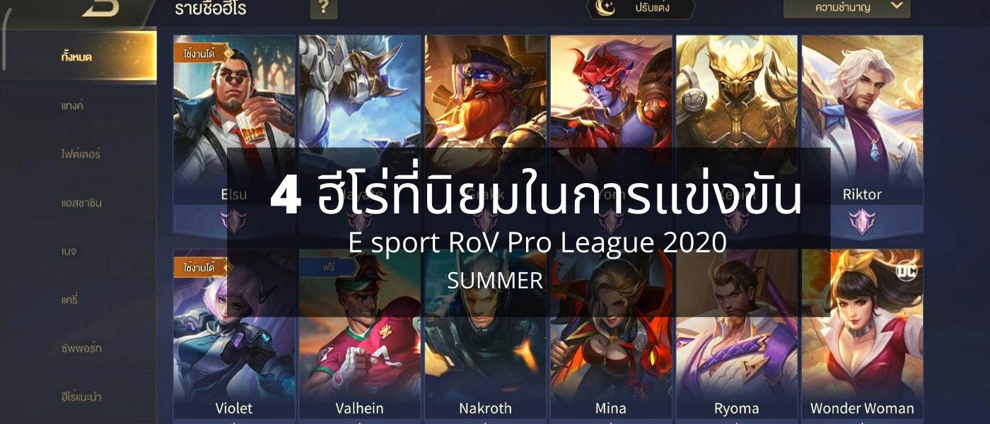

If you love this , Let’s try those…
Buffet Lover
Series Lover
Skincare Addicted
Travelling Content
Restaurant Review Content
Correlation 0.624
Shabu Shabu
Correlation 0.718
BBQ Lover
Correlation 0.628
Netflix
Correlation 0.716
Movie
Correlation 0.675
Makeup
Correlation 0.726
Fashion
Correlation 0.458
Travelling
Correlation 0.694
Reading Book
Gamer
I bet you will love it !
Online Articles
Correlation 0.767
Gaming Content
Correlation 0.799

Slide 4

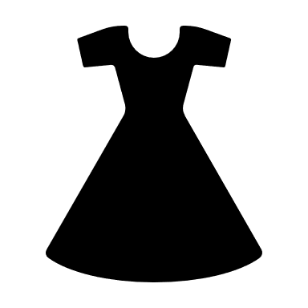



This is me
20-29
I love…
Extremely love it – 4
Really love it – 4
Love it - 4
Extremely love it – 5
Really love it – 1
Love it - 4
Extremely love it – 5
Really love it – 1
Love it - 5
Skincare
How many people who love something like you?
Fashion
Cosmetic
Workout
Extremely love it – 2
Really love it – 2
Love it - 7
Extremely love it – 2
Really love it – 2
Love it - 5
Healthy Food
Let’s figure it out in one click..

Slide 5
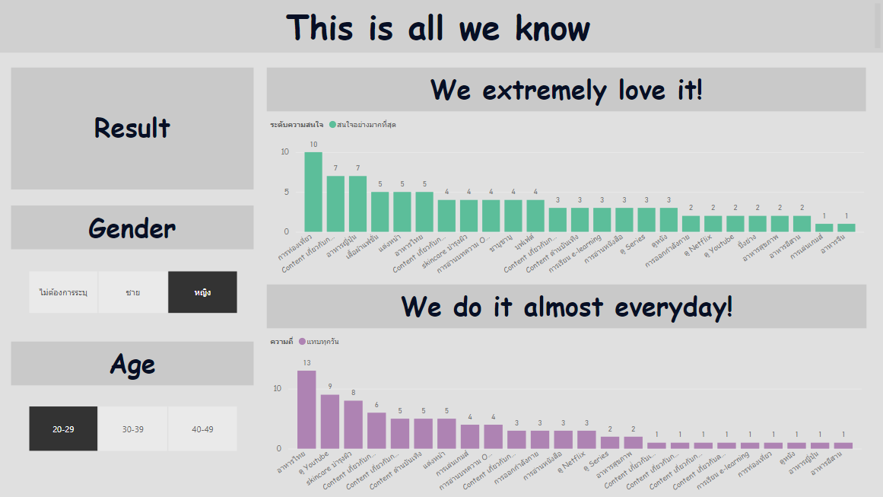

Slide 6
